Slide 1
Chemicals Safety Information System
Serges Pemba

Slide 2
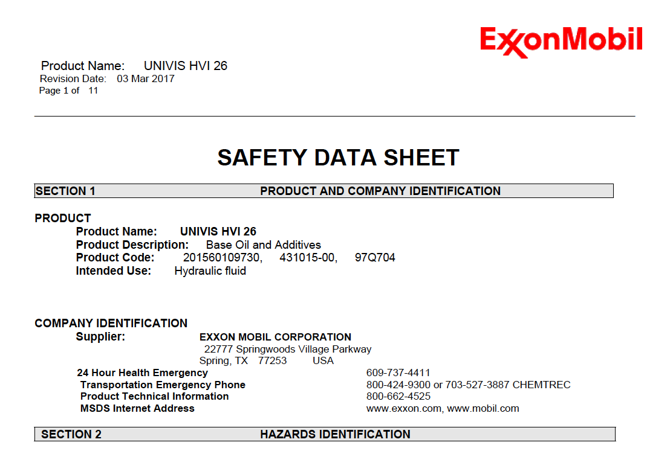
A system for access to safety and handling information of chemical products
Development in three phases (phase 1. and 2. completed)
J26 Oil first Aid?

Slide 3
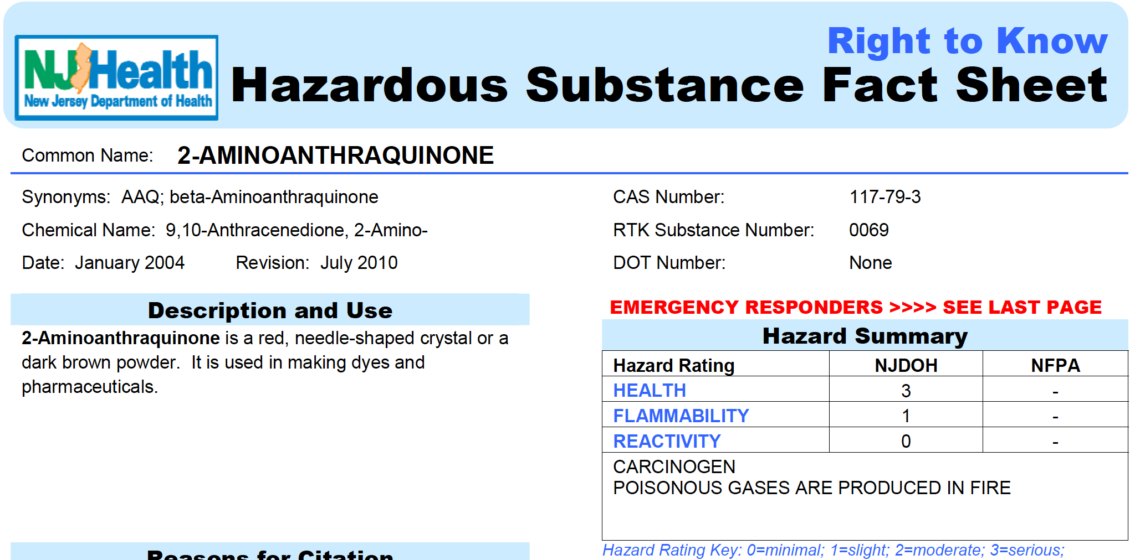
Data Collection
collect MSDS sheets for most commercial and domestic products
Collect pure chemicals data from diverse sources
e.g. Manufacturers
Convert data into text format and process

Slide 4
Search Engine
Build inverted index of collected data
Optimize ranking functions and parameters (BM25)
Create a working search engine

Slide 5
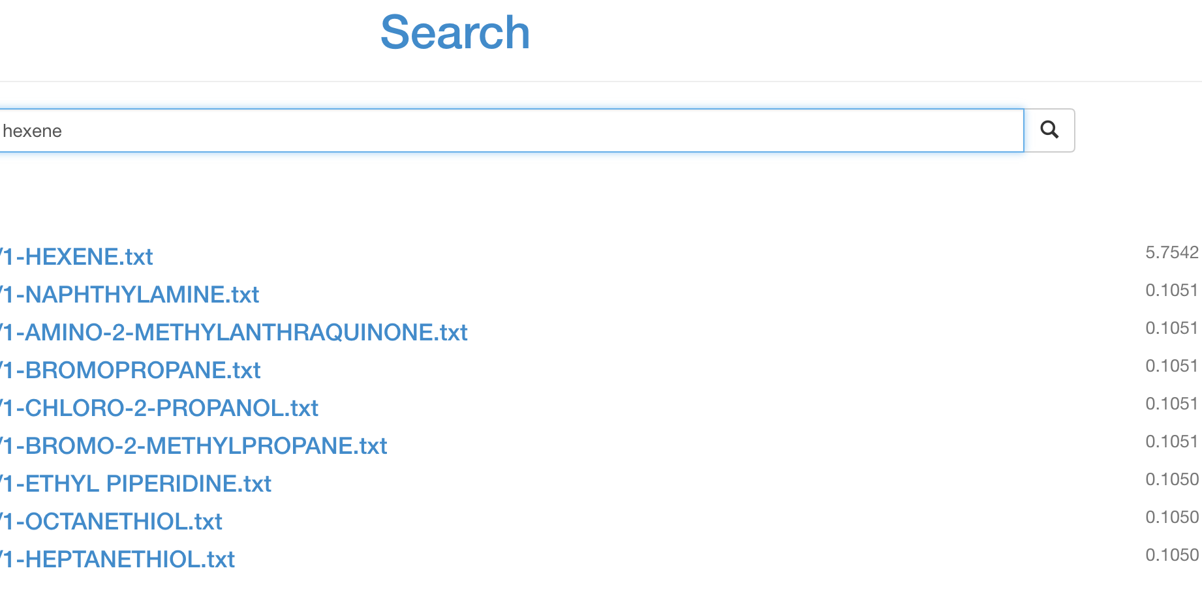
Search example

Slide 6
Future: Questions/ Answering
Process data for question/answers
Question restricted to categories
e.g. first aid, storage, handling…
Complete question/ answering systems

